Slide 1

Online Ticketing System for Fortis Technologies Inc.

Slide 2

Chapter 1 PROBLEM AND ITS BACKGROUND
Online Ticketing System for Fortis Technologies Inc.

Slide 3
Project Context
Developing a technology for the company’s productivity should be the main concern of the developers.
Fortis Technologies Inc, expertise in hardware’s, software’s, and people are value in their proposition, offering end to end solutions to the entire information technology stack.
The researchers conducted a research and learned that the developers of Fortis Technologies Inc. receives an average of 100 and plus of emails of the technical support team, requesting for support every day.
The researchers decided to create an Online Ticketing System for Fortis Technologies that will help the business process of the Fortis Technologies.
Online Ticketing System for Fortis Technologies Inc.

Slide 4
Objective
This study aims to develop a Ticketing System for Fortis Technologies Inc. to easily track and report the problem progress. Developing a technology for the company’s productivity should be the main concern of the researchers.
Online Ticketing System for Fortis Technologies Inc.

Slide 5
This study has the following specific objectives:
To design an interface for administrator, users and the clients
To develop a login/logout module for the users.
To develop a module for the administrator will be able to monitor and manage easily the reports regarding the technical support request of the clients.
To develop a module for the user to view and manage technical support request.
To develop a module for the clients of the Fortis Technologies Inc. that can create and view their requested technical support.
To create a module which the clients of Fortis Technologies Inc. can send technical support requests to the company.
To create a module that will show the status and severity of the ticket requested by the client.
Online Ticketing System for Fortis Technologies Inc.

Slide 6
Scope of the Project
The proposed project of the researchers is capable of creating issue or tickets which will be created by the clients, the clients can also view the progress of the tickets they have created. The clients can add comments to give their feedbacks on the support of the company.
The users of the system needs to login to access the system, users can view tickets and assign to them solves to fixed the problems.
The administrator of the system is capable of adding, update and deleting of user accounts in the system, the administrator can add, edit and delete in the maintenance module.
Online Ticketing System for Fortis Technologies Inc.

Slide 7
Chapter 2 REVIEW OF RELATED LITERATURE & STUDIES
Online Ticketing System for Fortis Technologies Inc.

Slide 8
Related studies
According to Johanna Ivarsson (2013) in her case study of an IT Helpdesk service, to solve the service quality issues this study recommends starting to work with measurability and continuous improvements.
According to Knapp (2013) consequently, help desks have evolved into service desks. Furthermore, the most critical issues faced by organizations in the service desk environment pertain to: (1) the structure of the service desk; and (2) how to improve user support.
According to Abdinnour (2011) the virtual service desk became prominent when networking capabilities increased. In the virtual service desk structure, end users get the impression of a single, central service desk when in fact the service desk representatives may be using online.
Online Ticketing System for Fortis Technologies Inc.

Slide 9
Related Literature
According to (Jantti 2013) the literature pertaining to management service desks encompasses the implementation of self-help knowledge management systems.
According to (R. Andriew’s 2011) article entitled “Supporting Your Product how to Provide Technical Support” .mplementation of self-help knowledge management systems.
The system provided a better alternative that will developed organizational pile handling and management. (H. Korth 2011) in “Database System Concepts”.
Online Ticketing System for Fortis Technologies Inc.

Slide 10
Chapter 3 DESIGN AND METHODOLOGY
Online Ticketing System for Fortis Technologies Inc.

Slide 11
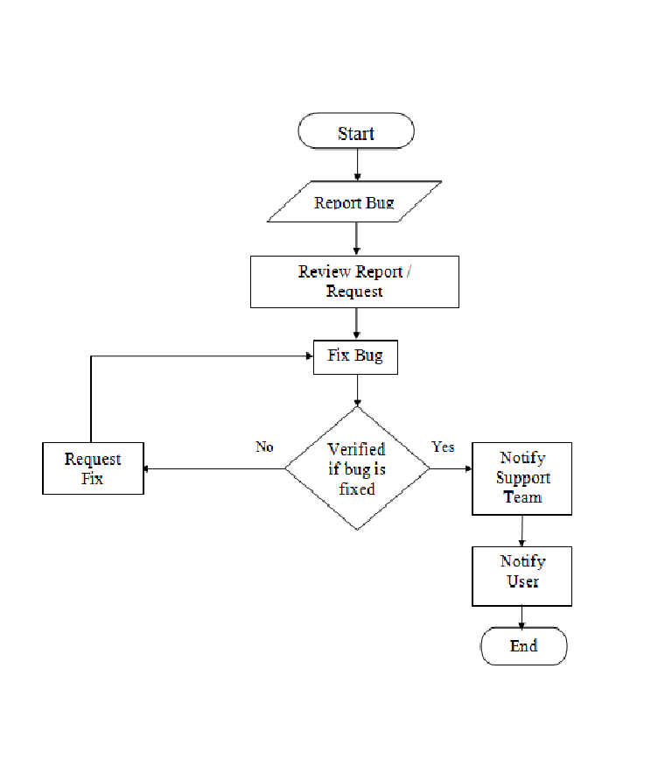
Requirement Analysis
Figure 1.0 - Flow chart of the current process of the Fortis Technologies Inc.
Online Ticketing System for Fortis Technologies Inc.

Slide 12
Requirement Documentation
Client module - This Create Ticket Module can create ticket that will be use for transaction with the company and View Ticket for clients which will able them to see the progress of the issue they sent.
Ticket Module – This module enables the administrator and the users to view the open tickets, the assigned tickets, closed tickets and those that are pending. In this module where they make the progress of the tickets.
Maintenance Module – This module is accessible only by the administrator. In this module the administrator can add, edit and delete status, severity and resolution.
Online Ticketing System for Fortis Technologies Inc.

Slide 13
Users Module – This module is accessible only by the administrator. In this module the administrator can add, edit, and delete user accounts for the system. The administrator also can activate and de-activate the user accounts.
Reports – This Module was designed to provide a feature-rich and user-friendly web interface for managing reports. The core idea behind the Reporting Module is to provide a solid foundation so that other developers can use the framework to implement new features.
Online Ticketing System for Fortis Technologies Inc.

Slide 14
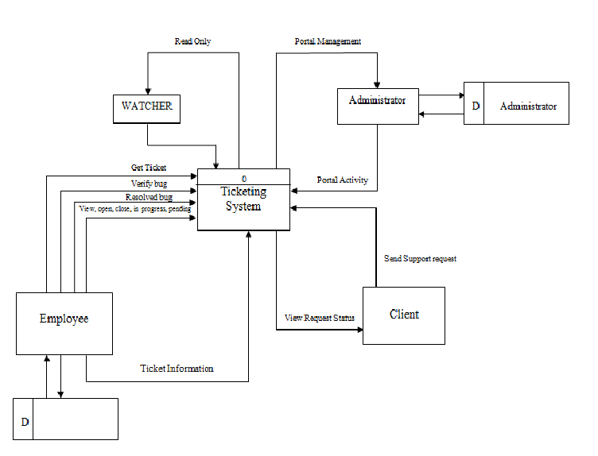
System Design
Figure 2.0 - Data Flow Diagram of the Online Ticketing System for Fortis Technologies
Online Ticketing System for Fortis Technologies Inc.

Slide 15
Development And Testing
To be able the gather the relevant information in the study, the researcher made use of iterative model methods is that they all focus on empowering people to collaborate and make decisions together quickly and effectively. Iterative model continuous planning, continuous testing, continuous integration, and other forms of continuous evolution of both the project and the software, where the proposed of the software or the system should be determined.
Online Ticketing System for Fortis Technologies Inc.

Slide 16
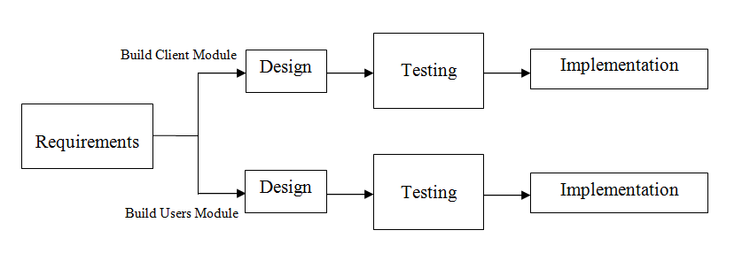
Figure 3.0 - Representation of the methodology use by the proponents
Online Ticketing System for Fortis Technologies Inc.

Slide 17
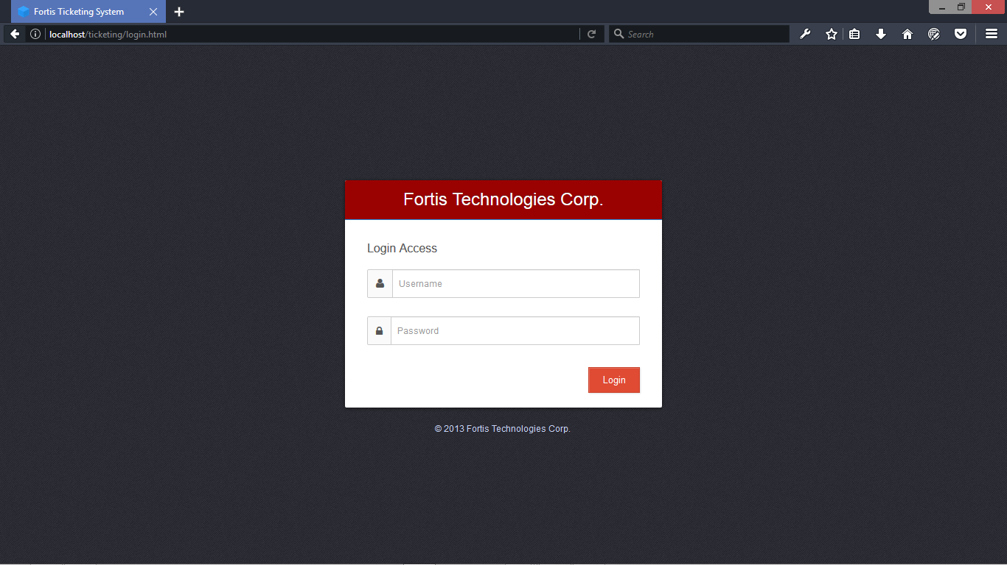
Description Of The Prototype
Figure 4.0 Login Form - This page is where the users of the system need to login to access the system.
Online Ticketing System for Fortis Technologies Inc.

Slide 18
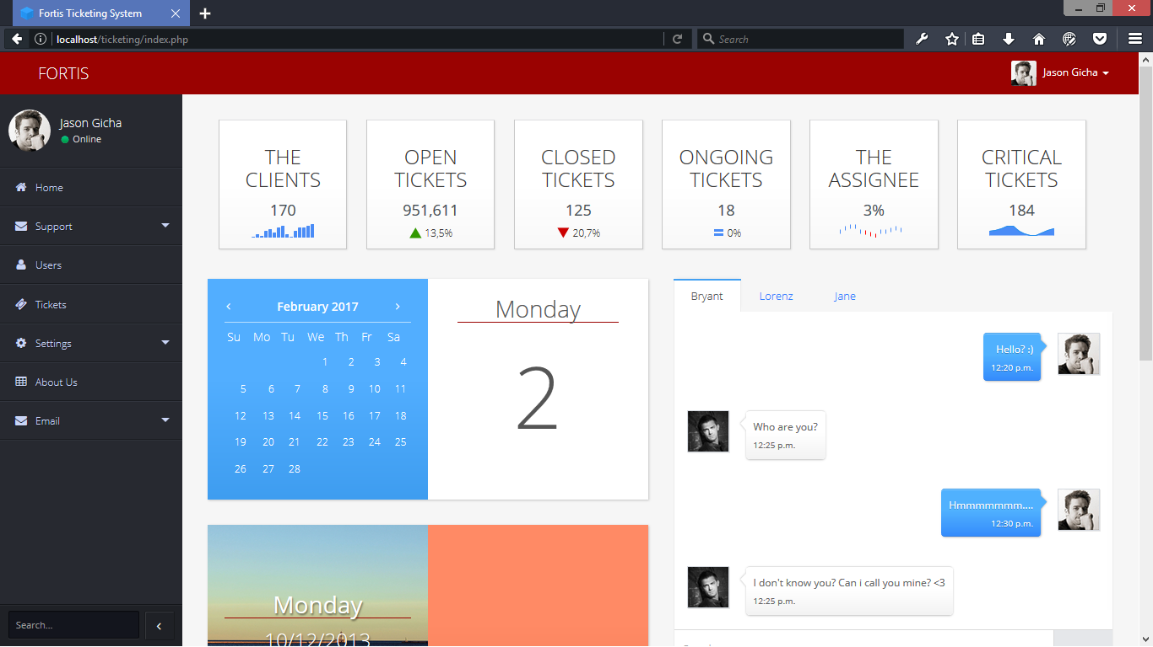
Figure 5.0 Admin Index - This Admin Index module will use to see and to manage the system.
Online Ticketing System for Fortis Technologies Inc.

Slide 19
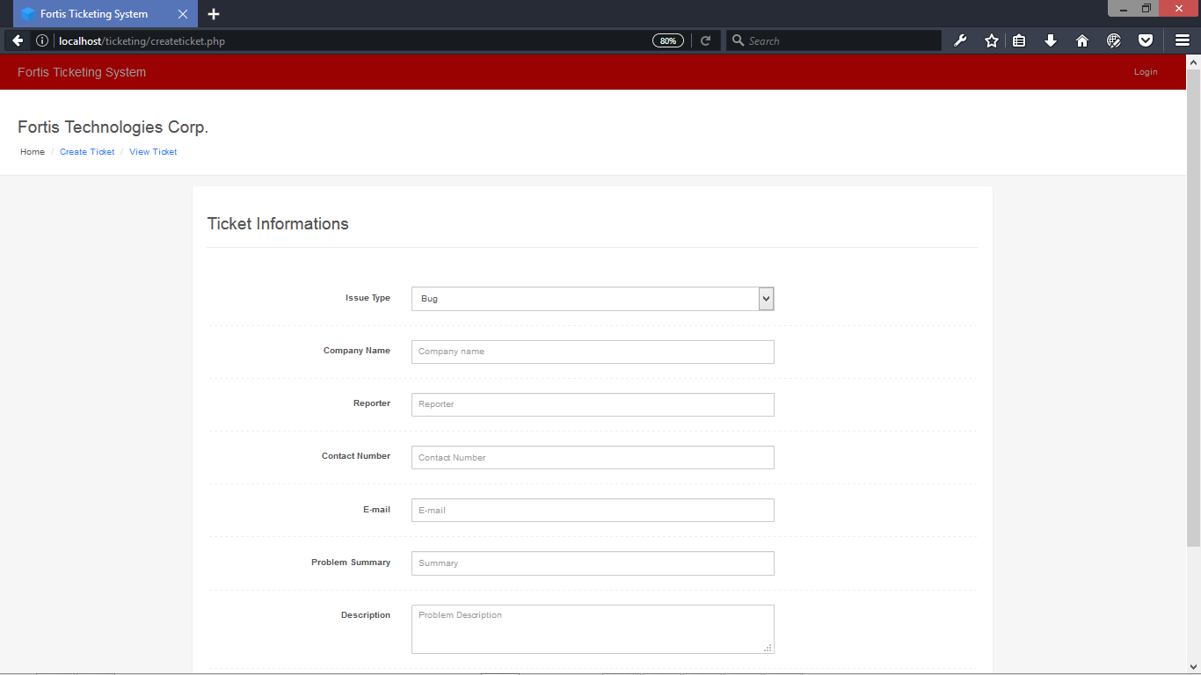
Figure 6.0 Create Ticket - This Create Ticket Module can create ticket that will be use for transaction with the company
Online Ticketing System for Fortis Technologies Inc.

Slide 20
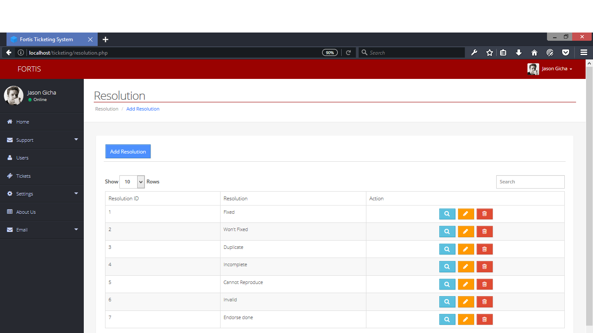
Figure 7.0 Setting Resolution - This Setting (Resolution) Module can add, edit, and delete resolutions.
Online Ticketing System for Fortis Technologies Inc.

Slide 21
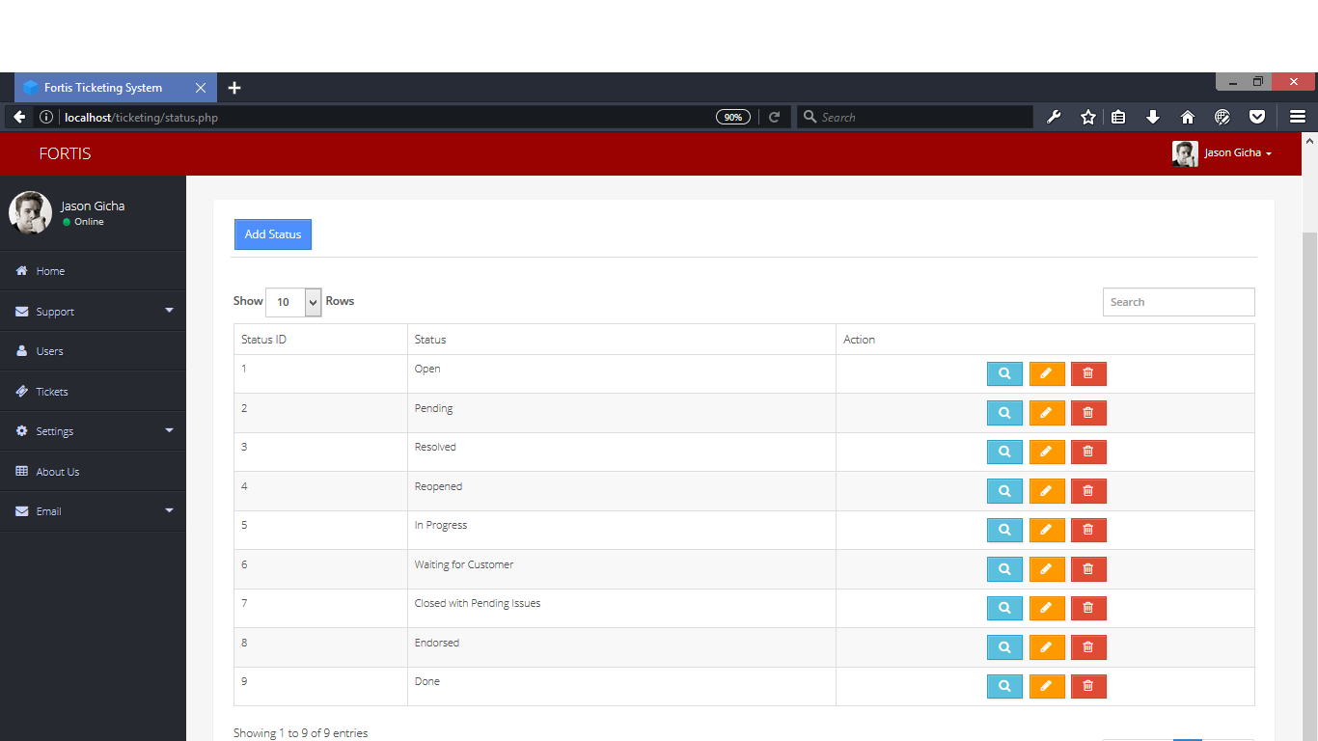
Figure 8.0 Setting Status - This Setting (Status) Module can add, edit, and delete status.
Online Ticketing System for Fortis Technologies Inc.

Slide 22
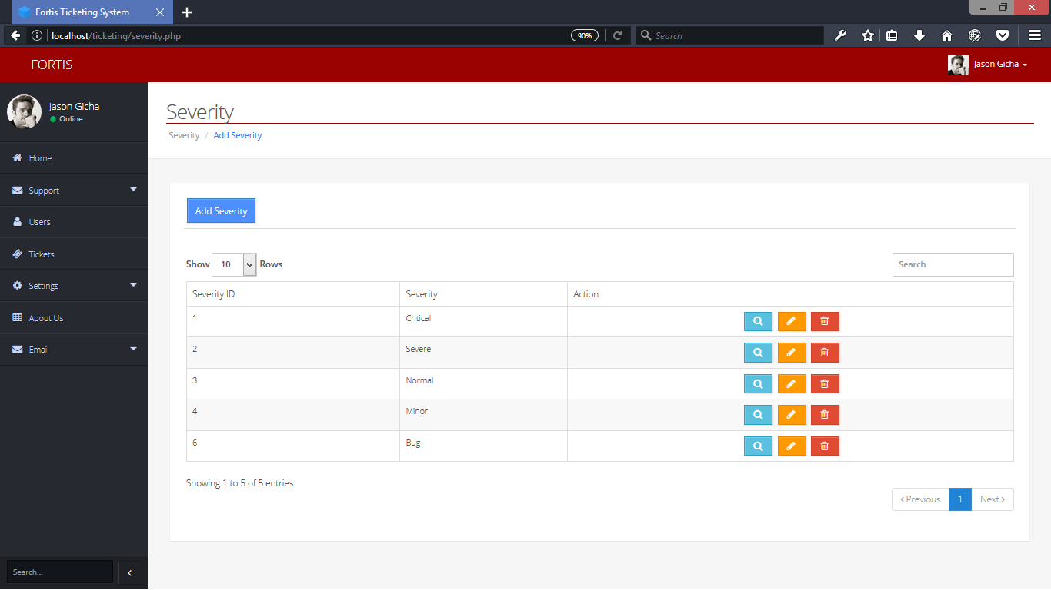
Figure 9.0 Setting Severity - This Setting (Severity) module can add, edit, and delete severity.
Online Ticketing System for Fortis Technologies Inc.

Slide 23
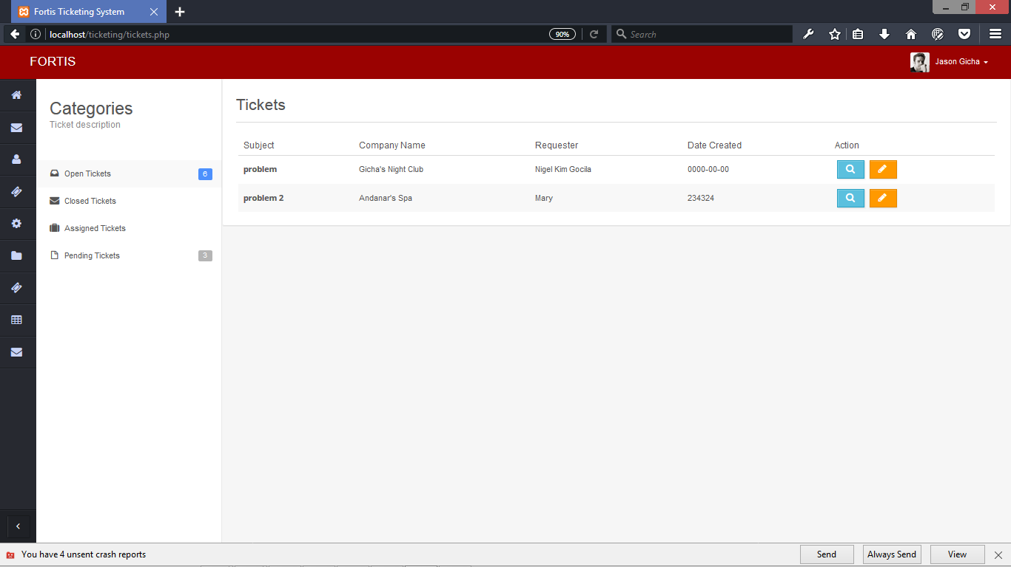
Figure 10.0 Ticket Module - This page is where the users and the administrator can see the status of the tickets and also update the status.
Online Ticketing System for Fortis Technologies Inc.

Slide 24
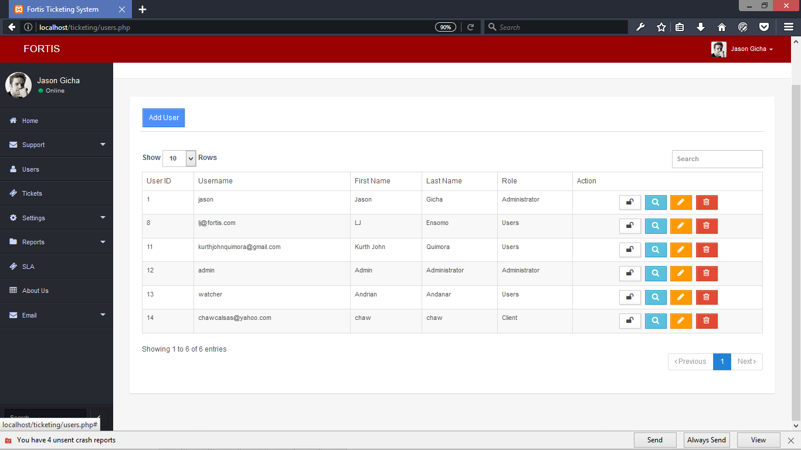
Figure 11.0 Add User - This page let the administrator to add, edit, delete, and lock the accounts of the users.
Online Ticketing System for Fortis Technologies Inc.

Slide 25
Implementation Plan
STRATEGY | ACTIVITIES | PERSON’S INVOLVED | DURATION
Approval from the Fortis Technologies Administrator | Letter’s for the Administrator for approval | Researchers, Administrator | 1 Day
System installation | Installation of the system to Fortis Technologies | Researcher’s Administrator | 5 Hours
Information Distribution | User’s guide | Administrator, Developers | 1 Day
Testing | Hands on Training and Lectures | Administrator, Developers | 7 Days
Online Ticketing System for Fortis Technologies Inc.

Slide 26
END
Online Ticketing System for Fortis Technologies Inc.

Slide 27
TITLE
Online Ticketing System for Fortis Technologies Inc.

